Slide 1

*metrics Project SUB Results
*metrics in Transition - Final Workshop
27-28 March 2019
SUB Göttingen
Maxie Gottschling, Astrid Orth

Slide 2
Community Engagement and Outreach
Project goals and findings were communicated in a large number of presentations, lighting talks, posters and a keynote at conferences and other events
Project partners took part in several workshops (Bibliothekartage, Open Access Tage, LIBER) and other hands-on formats (Open Science Barcamp, Toolmarktplatz, Hands-on-Labs)
During two successful project workshops a total of nearly 100 participants entered into in-depth discussions of project approaches, first findings and final results.

Slide 3
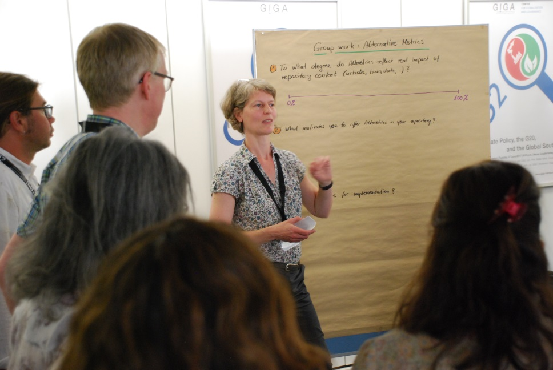
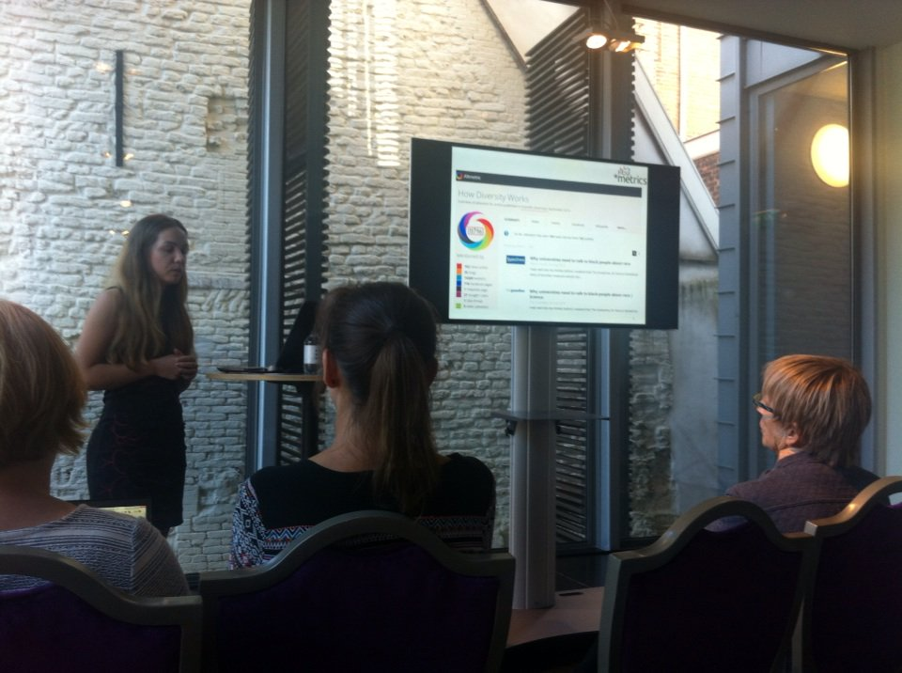
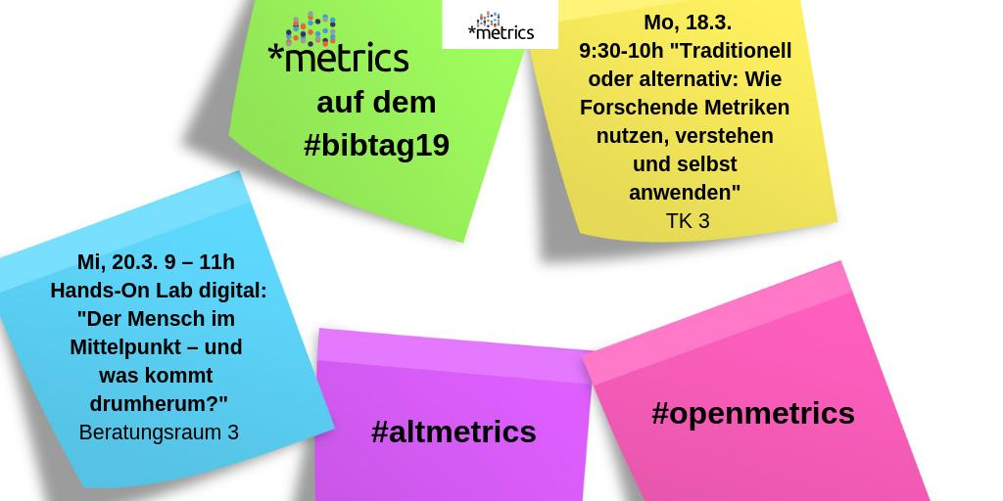
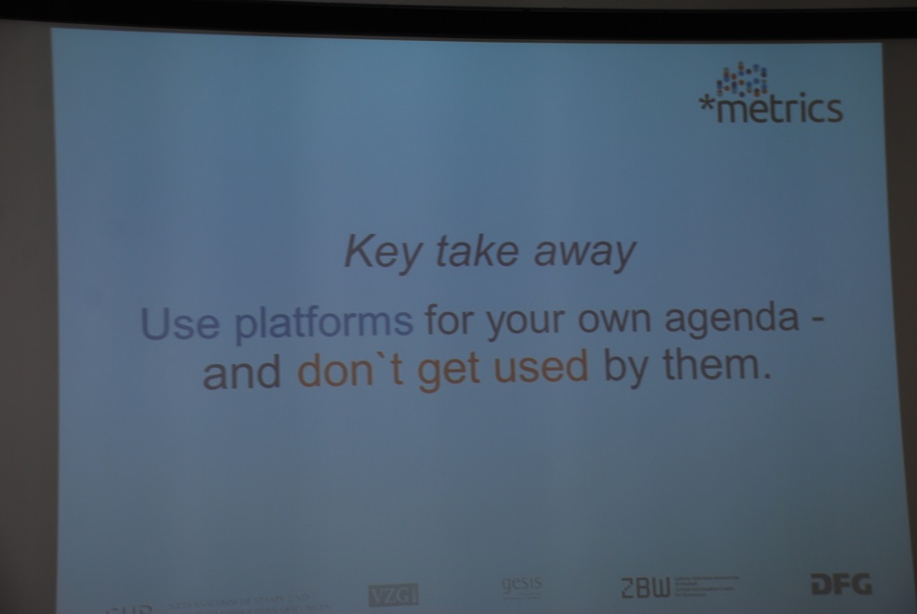
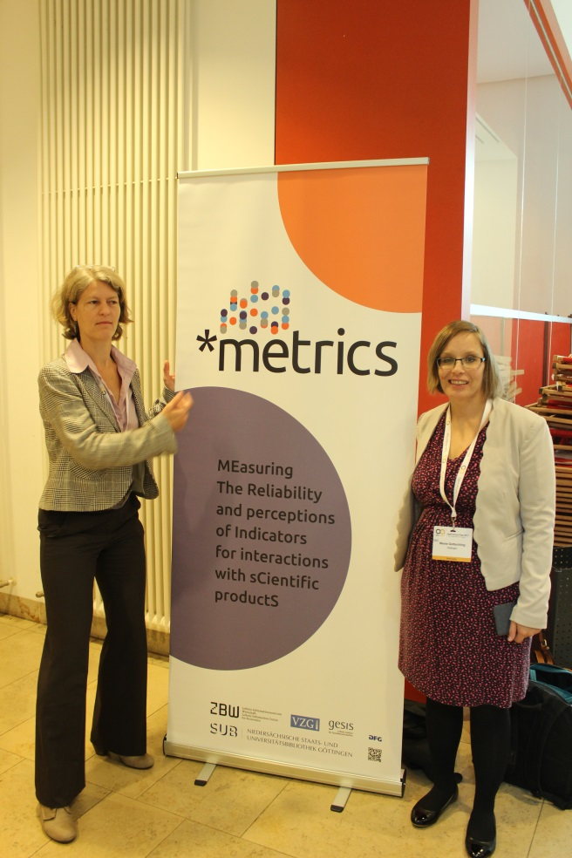
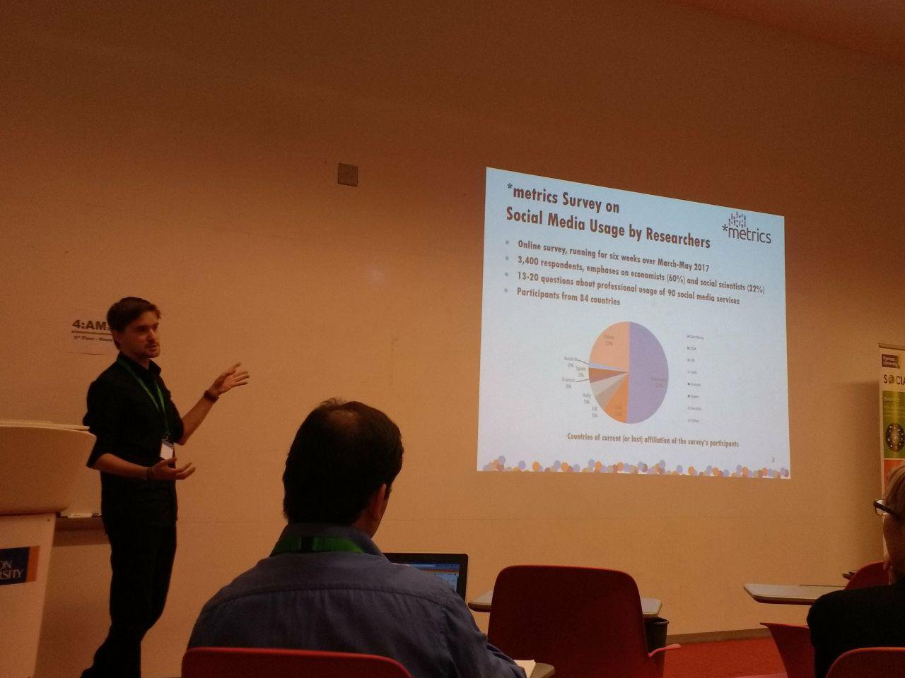
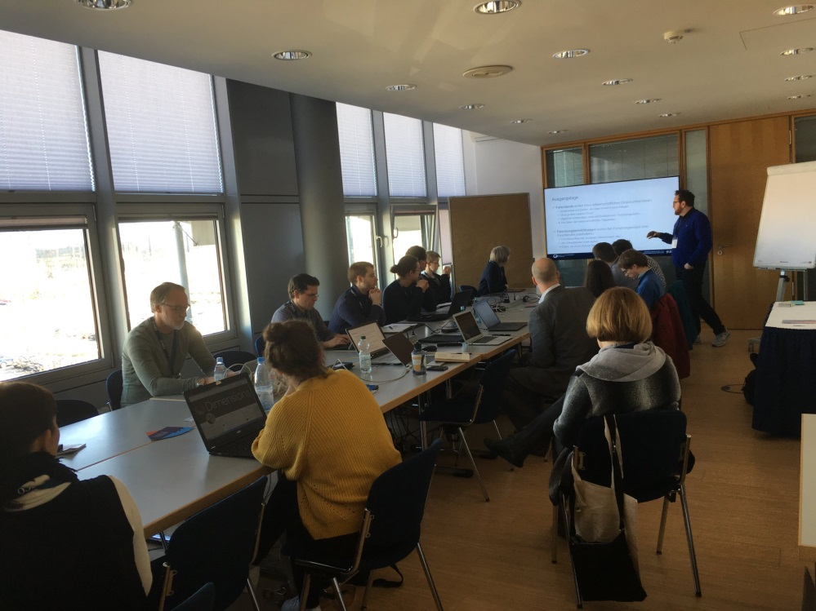

Slide 4



Dissemination
Project is being identified by a fresh and catchy project design transported by its logo, website, presentation template and materials like stickers, postcards, mobile cleaners and a banner.

Slide 5
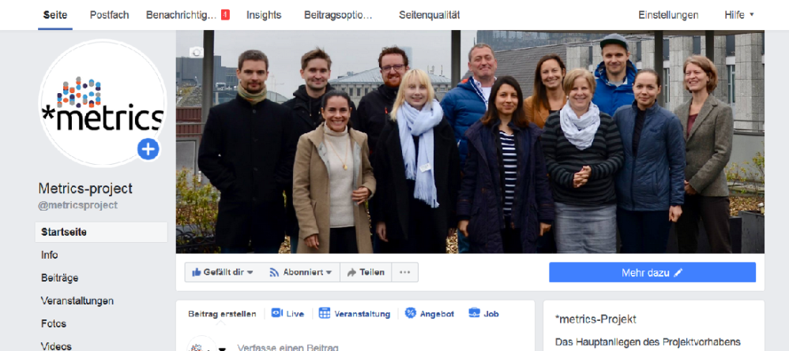
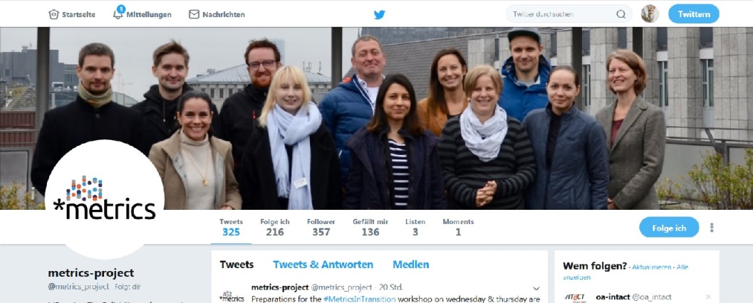
Social Media
The project is also represented in social media channels of Facebook and Twitter, whereof Twitter has shown the most outreach potential with 365 followers(as of 20th March 2019).

Slide 6
Social Media Registry
In the Social Media Registry (SoMeR) we list:
Social media plattforms and online services, that
Generate and capture social interactions related to scientific products (i.e. articles, datasets, ...)
What do we capture?
Platforms suitable for scientific communication
Types and nature of interactions
Availability and accessibility of social media indicators

Slide 7










SoMeR Top 10

Slide 8
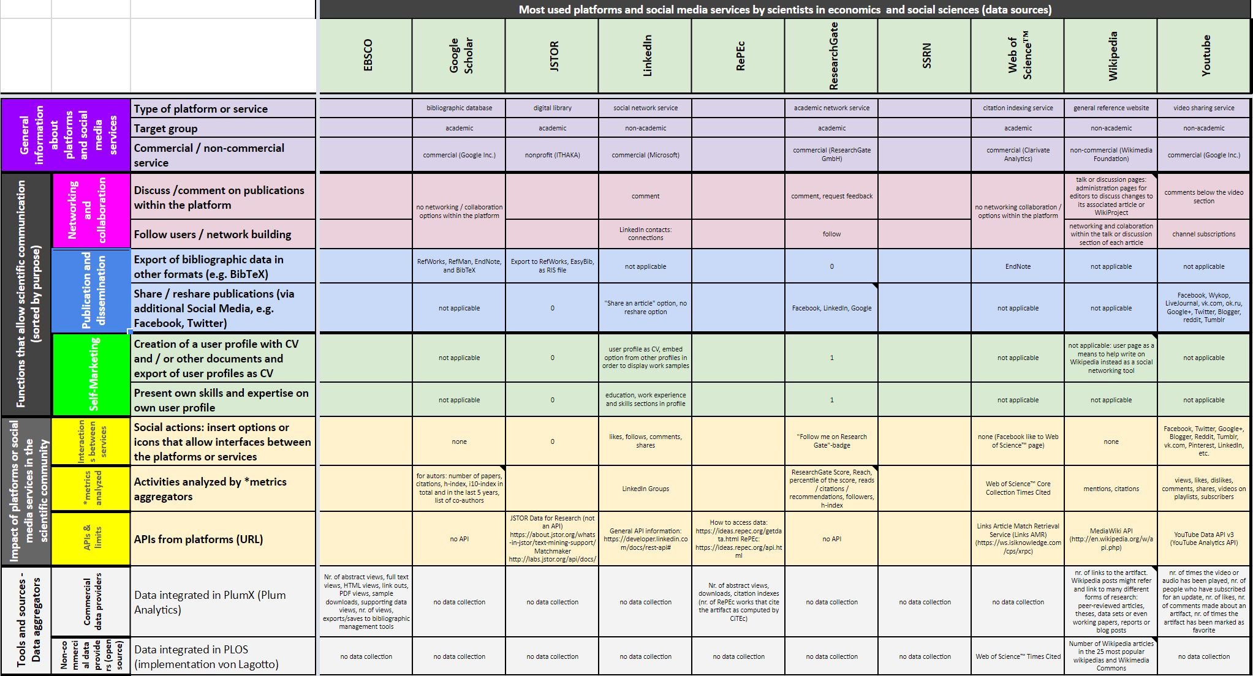
Social Media Registry
Notes:
(Link eingebaut in der Grafik)

Slide 9
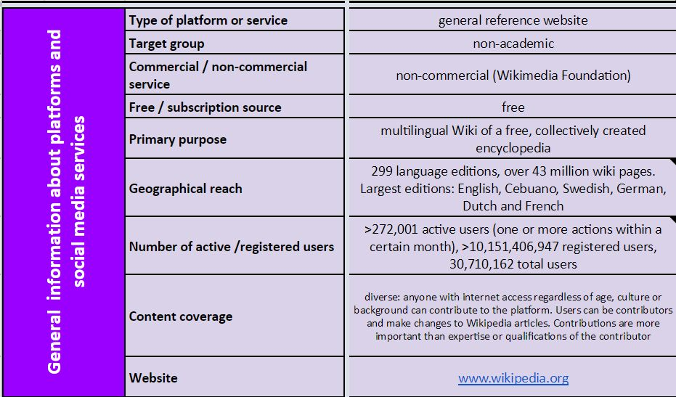
SoMeR Example Wikipedia

Slide 10
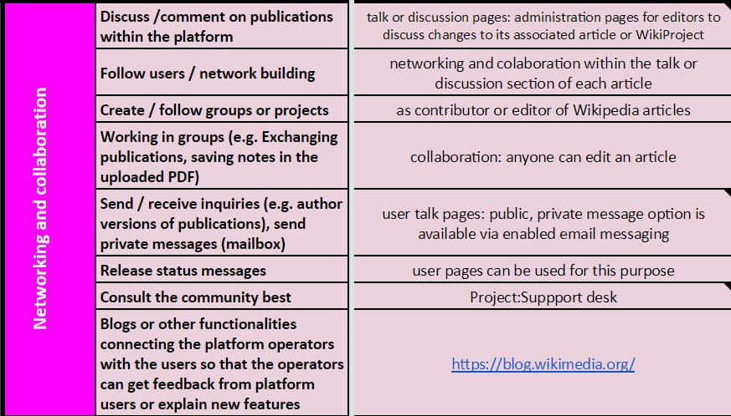
SoMeR Functions Group 1
networking and collaboration

Slide 11
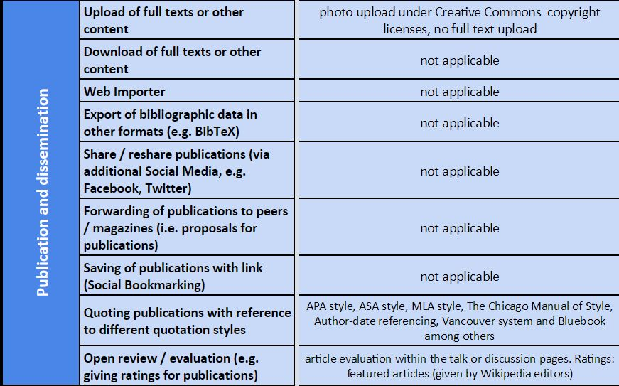
SoMeR Functions Group 2
publication and dissemination

Slide 12
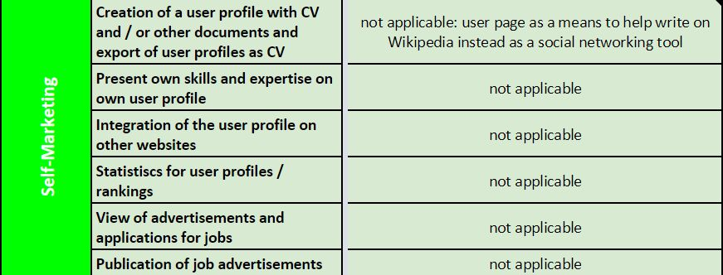
SoMeR Functions Group 3
self-marketing

Slide 13
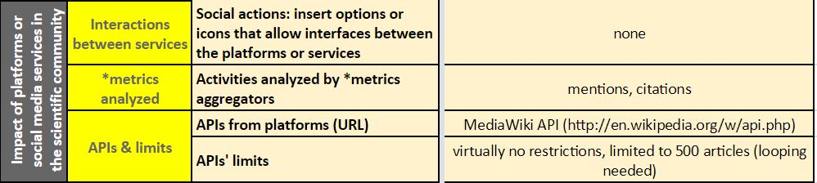
SoMeR – Interactions, *metrics & APIs

Slide 14
Discussion
Which platforms should be included?
How open and accessible are platforms?
Which aggregators include data of which platforms?
How are signals captured and aggregated?
Group work

Slide 15
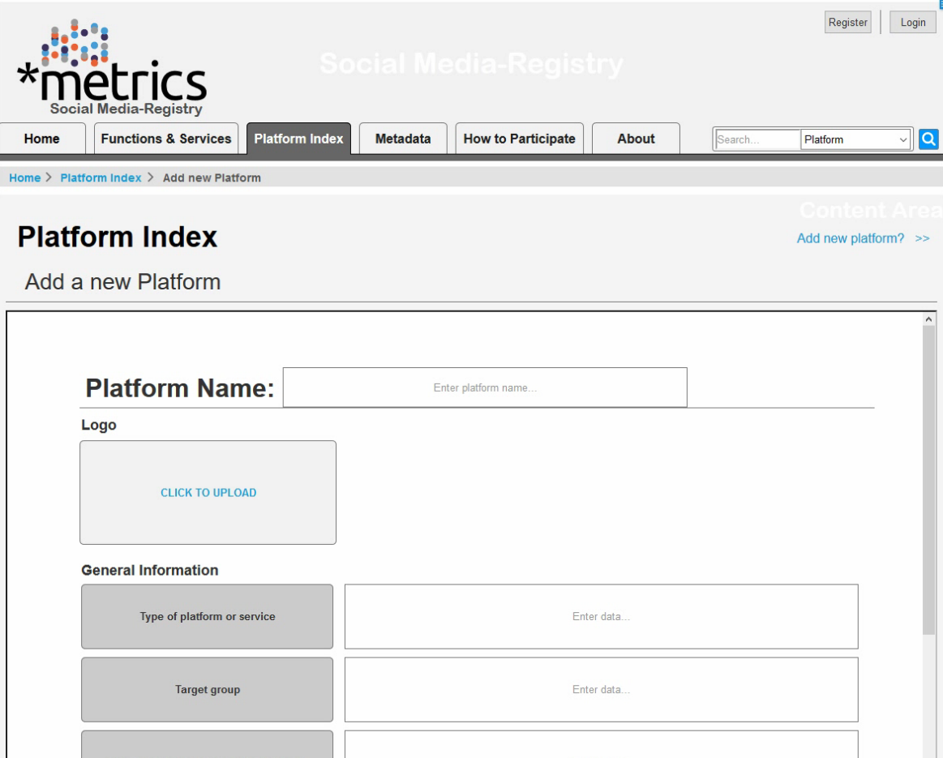
Database version

Slide 16
Questions?

Slide 17
Thank you / Vielen Dank!
Web metrics-project.net
E-Mail metrics-project@sub.uni-goettingen.de
Twitter @metrics_project
Facebook @metricsproject

